Slide 1
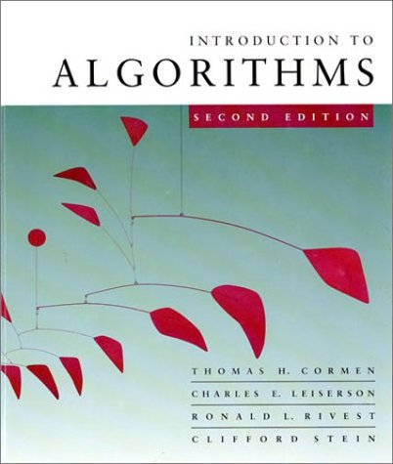
Introduction to Algorithms
6.046J
MIT Prof. Shafi Goldwasser

Slide 2
Solving recurrences
The analysis of integer multiplication from prev Lecture required us to solve a recurrence.
Recurrences are a major tool for analysis of algorithms
  Today: Learn a few methods.
Also: Divide and Conquer algorithms which are analyzable by recurrences.
L2.<number>

Slide 3
Recall: Integer Multiplication
Let X = A B and Y = C D where A,B,C and D are n/2 bit integers
Simple Method: XY = (2^{n/2}A+B)(2^{n/2}C+D)
Running Time Recurrence
T(n) < 4T(n/2) + 100n
How do we solve it?
L2.<number>

Slide 4
Simple Recurrence
T(n) = T(n-1) + 5
5 is just a constant c – it could be 1 could be 10million or 100 zillion
Here we have to do something 5n times
Complexity is thus O(n) – note we do not care about the constant in theory.
In practice 10million n will be slower than 5n
L2.<number>

Slide 5
Substitution method
The most general method:
Guess the form of the solution.
Verify by induction.
Solve for constants.
Example: T(n) = 4T(n/2) + 100n
[Assume that T(1) = Θ(1).]
Guess O(n³) . (Prove O and Ω separately.)
Assume that T(k) ≤ ck³ for k < n .
Prove T(n) ≤ cn³ by induction.
L2.<number>

Slide 6
Example of substitution
T
(
n
)
=
4
T
(
n
/
2
)
+
100n
≤
4
c
(
n
/
2
)
3
+
100n
=
(
c
/
2
)
n
3
+
100n
=
cn
3
−
((
c
/
2
)
n
3
−
100n
)
desired – residual
≤
cn
3
desired
whenever (c/2)n³ – 100n ≥ 0, for example, if c ≥ 200 and n ≥ 1.
residual
L2.<number>

Slide 7
Example (continued)
We must also handle the initial conditions, that is, ground the induction with base cases.
Base: T(n) = Θ(1) for all n < n₀, where n₀ is a suitable constant.
For 1 ≤ n < n₀, we have “Θ(1)” ≤ cn³, if we pick c big enough.
This bound is not tight!
L2.<number>

Slide 8
A tighter upper bound?
We shall prove that T(n) = O(n²).
Assume that T(k) ≤ ck² for k < n:
T
(
n
)
=
4
T
(
n
/
2
)
+
100n
≤
cn
2
+
100n
≤
cn
2
for no choice of c > 0. Lose!
L2.<number>

Slide 9
A tighter upper bound!
IDEA: Strengthen the inductive hypothesis.
Subtract a low-order term.
Inductive hypothesis: T(k) ≤ c₁k² – c₂k for k < n.
T
(
n
)
=
4
T
(
n
/
2
)
+
100n
≤
4
(
c
(
n
/
2
)
2
−
c
(
n
/
2
))
+
100n
1
2
=
c
n
2
−
2
c
n
+
100n
1
2
=
c
n
2
−
c
n
−
(
c
n
−
)
1
2
100n
2
≤
c
n
2
−
c
n
if c₂ > 100.
1
2
Pick c₁ big enough to handle the initial conditions.
L2.<number>

Slide 10
Recursion-tree method
A recursion tree models the costs (time) of a recursive execution of an algorithm.
The recursion tree method is good for generating guesses for the substitution method.
The recursion-tree method can be unreliable, just like any method that uses ellipses (…).
The recursion-tree method promotes intuition, however.
L2.<number>

Slide 11
Example of recursion tree
Solve T(n) = T(n/4) + T(n/2) + n²:
L2.<number>

Slide 12
Example of recursion tree
Solve T(n) = T(n/4) + T(n/2) + n²:
T(n)
L2.<number>

Slide 13
Example of recursion tree
Solve T(n) = T(n/4) + T(n/2) + n²:
n²
T(n/4)
T(n/2)
L2.<number>

Slide 14
Example of recursion tree
Solve T(n) = T(n/4) + T(n/2) + n²:
n²
(n/4)²
(n/2)²
T(n/16)
T(n/8)
T(n/8)
T(n/4)
L2.<number>

Slide 15
Example of recursion tree
Solve T(n) = T(n/4) + T(n/2) + n²:
n²
(n/4)²
(n/2)²
(n/16)²
(n/8)²
(n/8)²
(n/4)²
…
Θ(1)
L2.<number>

Slide 16

Example of recursion tree
Solve T(n) = T(n/4) + T(n/2) + n²:
n²
(n/4)²
(n/2)²
(n/16)²
(n/8)²
(n/8)²
(n/4)²
…
Θ(1)
L2.<number>

Slide 17
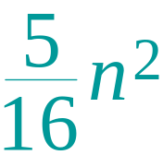
Example of recursion tree
Solve T(n) = T(n/4) + T(n/2) + n²:
n²
(n/4)²
(n/2)²
(n/16)²
(n/8)²
(n/8)²
(n/4)²
…
Θ(1)
L2.<number>

Slide 18
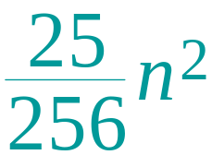
Example of recursion tree
Solve T(n) = T(n/4) + T(n/2) + n²:
n²
(n/4)²
(n/2)²
(n/16)²
(n/8)²
(n/8)²
(n/4)²
…
…
Θ(1)
L2.<number>

Slide 19
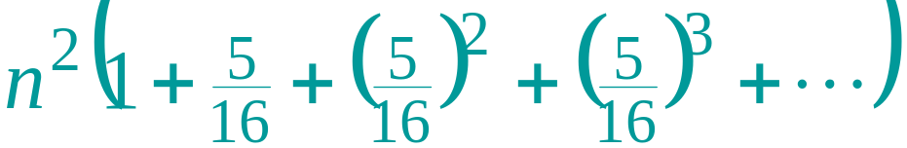
Example of recursion tree
Solve T(n) = T(n/4) + T(n/2) + n²:
n²
(n/4)²
(n/2)²
(n/16)²
(n/8)²
(n/8)²
(n/4)²
…
…
Θ(1)
Total =
= Θ(n²)
geometric series
L2.<number>

Slide 20
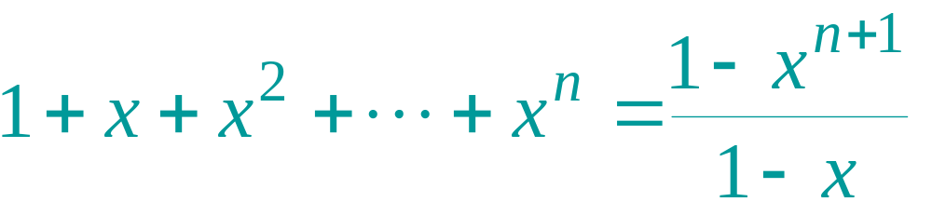
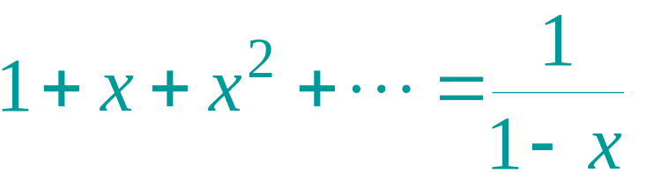
Appendix: geometric series
for x ≠ 1
for |x| < 1
Return to last slide viewed.
L2.<number>

Slide 21
The master method
The master method applies to recurrences of the form
T(n) = a T(n/b) + f (n) ,
where a ≥ 1, b > 1, and f is asymptotically positive.
L2.<number>

Slide 22
Idea of master theorem
Recursion tree:
f (n)
f (n)
a
f (n/b)
f (n/b)
…
f (n/b)
a f (n/b)
a
h = log_{b}n
f (n/b²)
f (n/b²)
…
f (n/b²)
a² f (n/b²)
…
…
#leaves = a^{h}
= a^{logbn}
= n^{logba}
n^{logba}Τ (1)
Τ (1)
L2.<number>

Slide 23
Three common cases
Compare f (n) with n^{logba}:
f (n) = O(n^{logba – ε}) for some constant ε > 0.
  f (n) grows polynomially slower than n^{logba} (by an n^{ε} factor).
Solution: T(n) = Θ(n^{logba}) .
L2.<number>

Slide 24
Idea of master theorem
Recursion tree:
f (n)
f (n)
a
f (n/b)
f (n/b)
…
f (n/b)
a f (n/b)
a
h = log_{b}n
f (n/b²)
f (n/b²)
…
f (n/b²)
a² f (n/b²)
…
…
CASE 1: The weight increases geometrically from the root to the leaves. The leaves hold a constant fraction of the total weight.
n^{logba}Τ (1)
Τ (1)
Θ(n^{logba})
L2.<number>

Slide 25
Three common cases
Compare f (n) with n^{logba}:
f (n) = Θ(n^{logba} lg^{k}n) for some constant k ≥ 0.
  f (n) and n^{logba} grow at similar rates.
  Solution: T(n) = Θ(n^{logba} lg^{k+1}n) .
L2.<number>

Slide 26
Idea of master theorem
Recursion tree:
f (n)
f (n)
a
f (n/b)
f (n/b)
…
f (n/b)
a f (n/b)
a
h = log_{b}n
f (n/b²)
f (n/b²)
…
f (n/b²)
a² f (n/b²)
…
…
CASE 2: (k = 0) The weight is approximately the same on each of the log_{b}n levels.
n^{logba}Τ (1)
Τ (1)
Θ(n^{logba}lg n)
L2.<number>

Slide 27
Three common cases (cont.)
Compare f (n) with n^{logba}:
f (n) = Ω(n^{logba + ε}) for some constant ε > 0.
  f (n) grows polynomially faster than n^{logba} (by an n^{ε} factor),
and f (n) satisfies the regularity condition that a f (n/b) ≤ c f (n) for some constant c < 1.
Solution: T(n) = Θ( f (n) ) .
L2.<number>

Slide 28
Idea of master theorem
Recursion tree:
f (n)
f (n)
a
f (n/b)
f (n/b)
…
f (n/b)
a f (n/b)
a
h = log_{b}n
f (n/b²)
f (n/b²)
…
f (n/b²)
a² f (n/b²)
…
…
CASE 3: The weight decreases geometrically from the root to the leaves. The root holds a constant fraction of the total weight.
n^{logba}Τ (1)
Τ (1)
Θ( f (n))
L2.<number>

Slide 29
Examples
Ex. T(n) = 4T(n/2) + n
a = 4, b = 2 ⇒ n^{logba} = n²; f (n) = n.
CASE 1: f (n) = O(n^{2 – ε}) for ε = 1.
∴ T(n) = Θ(n²).
Ex. T(n) = 4T(n/2) + n²
a = 4, b = 2 ⇒ n^{logba} = n²; f (n) = n².
CASE 2: f (n) = Θ(n²lg⁰n), that is, k = 0.
∴ T(n) = Θ(n²lg n).
L2.<number>

Slide 30
Examples
Ex. T(n) = 4T(n/2) + n³
a = 4, b = 2 ⇒ n^{logba} = n²; f (n) = n³.
CASE 3: f (n) = Ω(n^{2 + ε}) for ε = 1
and 4(cn/2)³ ≤ cn³ (reg. cond.) for c = 1/2.
∴ T(n) = Θ(n³).
Ex. T(n) = 4T(n/2) + n²/lg n
a = 4, b = 2 ⇒ n^{logba} = n²; f (n) = n²/lg n.
Master method does not apply. In particular, for every constant ε > 0, we have n^{ε} = ω(lg n).
L2.<number>

Slide 31
Conclusion
applying the master method.
For proof of master theorem – CLRS book
L2.<number>

